Slide 1
FHIR for Executives
Lloyd McKenzie
July 13, 2015

Slide 2
This presentation
Can be downloaded here:
http://gforge.hl7.org/svn/fhir/trunk/presentations/2015-07 FHIR Institute/FHIR for Executives.pptx
Use “anonymous” and email address to logon
Is licensed for use under the Creative Commons, specifically:
Creative Commons Attribution 3.0 Unported License
(Do with it as you wish, so long as you give credit)

Slide 3

Who am I?
Name: Lloyd McKenzie
Company: Gevity
Background:
One of FHIR’s 3 principle editors
Co-chair FHIR Management Group, Modeling & Methodology, FHIR Infrastructure
Former Chair HL7 Canada Architecture & Infrastructure
Heavily involved in HL7 and healthcare exchange for last 15 years (v2, v3, CDA, etc.)

Slide 4
Tutorial Objectives
You should:
Know where FHIR fits in the broader healthcare landscape, including other HL7 specifications
Be able to explain what FHIR is to others in your organization
Be able to evaluate whether and how FHIR is relevant to your organization and within what timelines
Have a basic picture of what’s happening in the FHIR implementation space right now
Notes:
9:15

Slide 5
Outline
Before break
After break
Why FHIR?
What makes FHIR different?
Core principles
FHIR Resources
Power of an interface
How does FHIR Compare?
FHIR Status
Where is FHIR being used?
Risks & Next steps
Notes:
Each day – 1 hour presentation, 30 minutes

Slide 6
WHY FHIR?

Slide 7
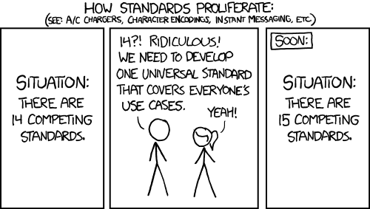
http://xkcd.com/927

Slide 8
Existing standards and bodies
HL7 – v2, v3, CDA
OpenEHR
CDISC – SDTM, ADAM, define.xml
X12
CTS
ISO – 11179, 21090, etc.
DICOM
W3C – Xforms, XSD
Many others
Do we really need one more?
Notes:
(in the healthcare space)

Slide 9
The Need
Has been a need to share healthcare information electronically for a long time
HL7 v2 is nearly 30 years old
Increasing pressure to broaden scope of sharing
Across organizations, disciplines, even borders
Mobile & cloud-based applications
Faster – integration in days or weeks, not months or years
Notes:
Who

Slide 10
What we have – v2
Works relatively well within institutions
But
Legacy, custom syntax (learning curve, tools)
Messaging design limits architectures
Doesn’t scale well across organization boundaries
Security/privacy infrastructure is minimal
A potpourri of segments and fields with no means to distinguish the common from edge case

Slide 11
What we have – v3
Newer technology and semi-robust reference model, but
Steep learning curve
Primary implementations by those with $$$$s
No inter-version wire compatibility
International specifications are too abstract, regional implementations don’t interoperate

Slide 12
What we have - CDA
Broad implementation, human-to-human interoperability, but:
Still a very steep learning curve
Interoperability beyond a human-to-human level is still a challenge, even with templates
Document architecture doesn’t fit all problems
Still a diversity of implementations
Extensibility is difficult

Slide 13
So I should drop everything and use FHIR?
Tossing functioning systems the instant a promising newcomer appears is not generally a wise strategy
There’s room for something better
FHIR tries to fill that gap
Market will decide whether FHIR survives, coexists or replaces other products
Notes:
There are flaws in what exists
There are new use-cases not being met

Slide 14
Problems we face
No central authorities
Permutation of biological and sociological complexity
Fractal use cases
Economics favours balkanization
Externalizing complexity
Much confusion about the problem

Slide 15
Complexity Model
Snomed
HL7 V3
openEHR
WS
CDA
Difficulty (log)
XML
HL7 v2
How?
HTTP / HTML
Text
Semantic Depth

Slide 16
Three Laws of Interoperability
Interoperability: It’s all about the people
You can hide the complexity, or make it worse, but you can’t make it go away
Cheap, flexible, and interoperable: pick two
Notes:
Disagreement
Average cost of existence
Examples
Qualifications – not quite true

Slide 17
Platform for Interoperability
Build capability for all systems
Only fix behavior
When everyone agrees to it
When it creates capability or simplicity
Push constraints on behavior to “Implementation Guides”
FHIR is loose, but capable
Implementation space will be fractal ☹

Slide 18
What is FHIR?
And how is it different?

Slide 19
The acronym
F – Fast (to design & to implement)
Relative – No technology can make integration as fast as we’d like
H – Healthcare
That’s why we’re here
I – Interoperable
Ditto
R – Resources
Building blocks – more on these to follow
Notes:
9:25

Slide 20

Genesis of FHIR
What would healthcare exchange look like if we started from scratch using modern approaches?
Web search for success markers led to RESTful based APIs
Exemplar: Highrise (https://github.com/37signals/highrise-api)
Drafted a healthcare exchange API based on this approach

Slide 21
FHIR – Key differences
Focus on Implementers
Target support for common scenarios
Leverage cross-industry web technologies
Require human readability as base level of interoperability
Make content freely available
Support multiple paradigms & architectures
Demonstrate best practice governance
Notes:
We don’t actually have a formal manifesto, but these are the principles we adhere to.

Slide 22
Implementer Focus
Specification is written for one target audience: implementers (that’s not just programmers)
Rationale, modeling approaches, etc. kept elsewhere
Multiple reference implementations from day 1
Publicly available test servers
Starter APIs published with spec
C#, Java, Pascal, Swift, more coming
Connectathons to verify specification approaches
Instances you can read and understand ☺
Lots of examples (and they’re valid too)
using HL7.Fhir.Instance.Model;
using HL7.Fhir.Instance.Parsers;
using HL7.Fhir.Instance.Support;
XmlReader xr = XmlReader.Create(
new StreamRead
IFhirReader r = new XmlFhirReader
// JsonTextReader jr = new JsonTe
// new StreamRead
// IFhirReader r = new JsonFhirRe
ErrorList errors = new ErrorList(
LabReport rep = (LabReport)Resour
Assert.IsTrue(errors.Count() == 0
Notes:
Spec is driven by people who write code
Numerous pieces have been changed because of experience with what worked when trying to implement
Even have a test workbench for RESTful servers

Slide 23
Support “Common” Scenarios
80%
Inclusion of content in core specification is based on “80%” rule
Only include data elements we are confident that most (~80%) of normal implementations using that resource will make use of
Other content in extensions (more on this later)
Easy to say, governance challenge to achieve
Resources are simple and easy to understand & use
Notes:
Design by constraint failed – years to develop, what was produced required yet more design to be implementable and after that might not be interoperable
How to determine the 80%? Look to existing specs – v2, v3, CDA templates, OpenEHR, jurisdictional projects, what implementations we’ve seen
If not sure, err on the side of “not in for now”
Note: not 80% of instances, 80% of implementations
Challenges with “raising the bar”
What happens when there aren’t many/any implementations?

Slide 24
Example – ISO AD type
isNotOrdered, updateMode, flavorId, nullFlavor, controlAct root & extension, validTime low and high, useable period (GTS – no room on the slide), use
home, primary home, vacation home, workplace, direct, public, bad, physical, postal, temporary, alphabetic, ideographic, syllabic, search, soundex, phonetic
0..* parts, each with:
value, code, code system, code system name, code system version, language, type:
address line, additional locator, unit identifier, unit designator, delivery address line, delivery installation type, delivery installation area, delivery installation qualifier, delivery mode, delivery mode identifier, street address line, building number, building number numeric, building number suffix, street name, street name base, street type, direction, intersection, care of, census tract, country, county or parish, municipality, delimiter, post box, precinct, state or province, postal code, delivery point identifier
Notes:
How many of your systems have user interfaces that support even ¼ of this?

Slide 25
Example – FHIR Address
isNotOrdered, updateMode, flavorId, nullFlavor, controlAct root & extension, validTime low and high, useable period (low, high) (GTS – no room on the slide), use
home, primary home, vacation home, workplace, direct, public, bad, physicalvisit, postal, temporary, alphabetic, ideographic, syllabic, search, soundex, phonetic, old
0..* parts, each with:text
value, code, code system, code system name, code system version, language, type:
address line, additional locator, unit identifier, unit designator, delivery address line, delivery installation type, delivery installation area, delivery installation qualifier, delivery mode, delivery mode identifier, street address line, building number, building number numeric, building number suffix, street name, street name base, street type, direction, intersection, care of, census tract, country, county or parish, municipalitycity, delimiter, post box, precinct, state or province, postalCode, delivery point identifier
Notes:
This is what happens when you apply the 80% . . .

Slide 26
Won’t extensions break interoperability?
The 80% + narrative helps provide “base” interoperability
For “robust” interoperability
Profile – constrains structure
Conformance – constrains behavior
Needed to claim “I’m FHIR conformant”
Notes:
1000s of extensions, everyone supports different things, don’t know what anyone does
Not everyone will support the 80%, but most will
“What most systems support” (and thus what you should probably support too) encourages base interoperability
Human readable fallback
Profile – what elements are supported, registries available
Conformance – REST operations, documents, messages, services

Slide 27
Web technologies
Instances shared using XML & JSON
Web calls work the same way they do for Google & Twitter
Rely on HTTPS, OAuth, etc. for security functions
Benefits
Cross-Industry standards
Well supported by tools
Understood by developers
http://...
Notes:
We try very hard to *not* invent stuff that exists elsewhere unless it’s really broken or totally unaligned with the FHIR principles.

Slide 28

Human Readable
Clinical Documents has both narrative and data
The data / narrative dynamic exists throughout the process
In FHIR, every resource can (should) have a human-readable expression
Can be direct rendering or human entered
Notes:
Even when you think your target will understand all the encoded data, reality is data often gets shared beyond the originally intended context
Allow for exceptions for things like automated device readings, etc.

Slide 29
Freely available
Unencumbered – free for use, no membership required
http://hl7.org/fhir + other versions
Licensed under CC0: True public domain
Any use is allowed
HL7 enforces the trademark protection
Notes:
Was a bigger deal before HL7 decided to open up all IP
full legal text towards bottom of FHIR home page

Slide 30
Paradigms
FHIR supports 4 interoperability paradigms
REST – Lightweight, leverages web stack
Documents – Long-term persistence
Messages – Request/response paradigm
Services – other SOA-based interfaces
Regardless of approach, content stays the same
Can leverage same models, same profiles everywhere

Slide 31
Review
What are FHIR’s 7 “Key Differences”

Slide 32

Architectures
FHIR makes no assumptions about the architectural design of systems
Notes:
Light or heavy clients
Central server or peer-to-peer sharing
Push or pull
Query or publish/subscribe
Loosely coupled or tightly coupled environments
With history tracking or without

Slide 33
FHIR & Cost of Integration
These factors will drive down the cost of integration and interoperability
Easier to Develop
Easier to Troubleshoot
Easier to Leverage in production
More people to do the work (less expensive consultants)
Competing approaches will have to match the cost, or disappear – effect is already being felt

Slide 34
Future impact of FHIR
Impact of FHIR on the market:
Drive interoperability prices down
Higher Expectations
Increased spend on integration (N x 2!)
Overall Market focus
PHR on the web
Healthcare repositories (MHD+)
Device Data management
Freeing data can enable new business models and new companies
Notes:
How much integration do you need? Nx2 – twice what you have

Slide 35
FHIR Resources
Notes:
10:00

Slide 36
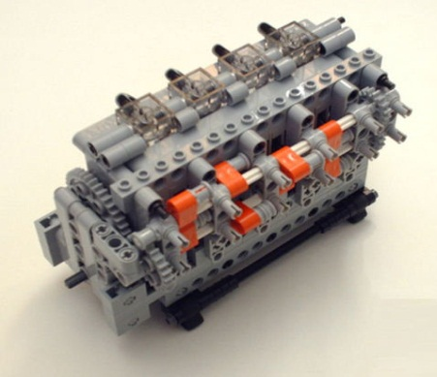
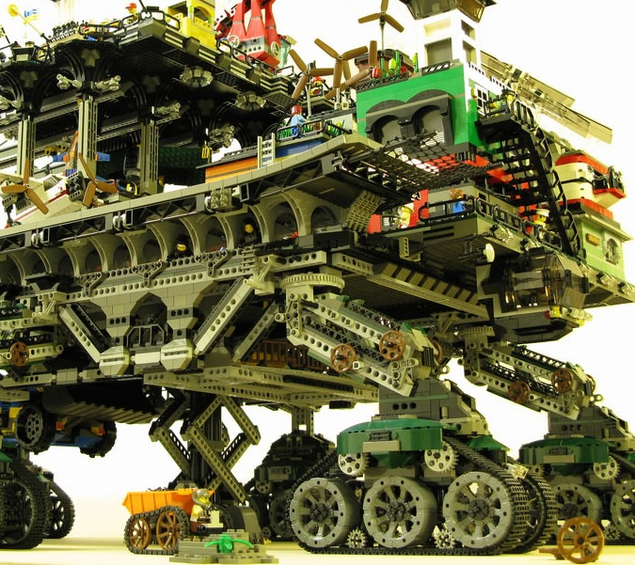

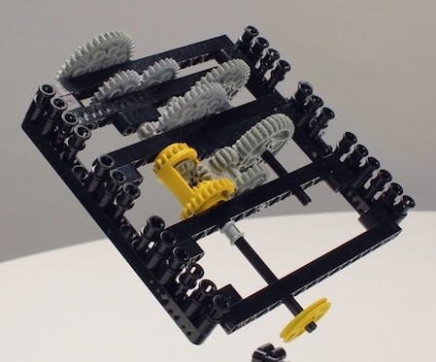
FHIR solutions
Resources
Extensions
Solution
+
=
Notes:
Resources are building blocks, but useful in their own right
Extensions supplement what resource doesn’t cover
Solutions can be simple or complex

Slide 37

Resources
“Resources” are:
Small logically discrete units of exchange
Defined behaviour and meaning
Known identity / location
Smallest unit of transaction
“of interest” to healthcare
V2: Sort of like Segments
V3: Sort of like CMETs

Slide 38
FHIR Resource URLs
Template | Description | Example | Operations
[base] | Server URL | http://fhir.com | OPTIONS, POST
[base]/[type] | Collection Manager | http://fhir.com/Patient | GET, POST
[base]/[type]/[id] | URL for a resource | http://fhir.com/Patient /23 | GET, PUT, DELETE
[base]/[type]/[id]/$[name] | Operation (server action) | http://fhir.com/Patient /23/$everything | POST
[base]/[type]/[id]/_history/[vid] | Past version | http://fhir.com/Patient/23/_history/2 | GET

Slide 39
What’s a Resource?
Examples
Non-examples
Administrative
Patient, Practitioner, Organization, Location, Coverage, Invoice
Clinical Concepts
Allergy, Condition, Family History, Care Plan
Infrastructure
Document, Message, Profile, Conformance
Gender
Too small
Electronic Health Record
Too big
Blood Pressure
Too specific
Intervention
Too broad
100-150 total - ever
Notes:
And few systems will ever see more than 40-50

Slide 40
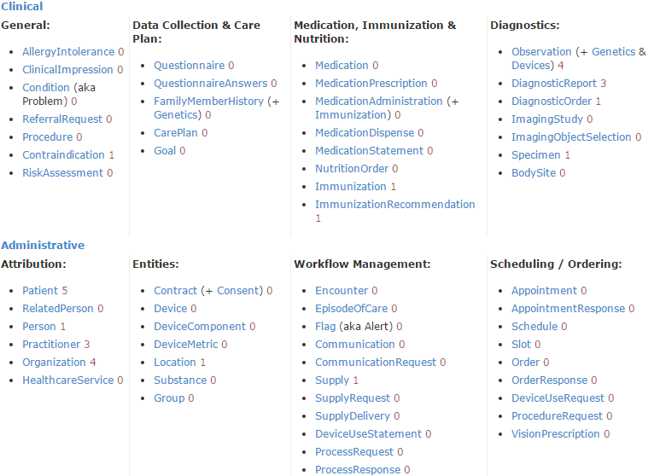
DSTU 2 Resource List

Slide 41
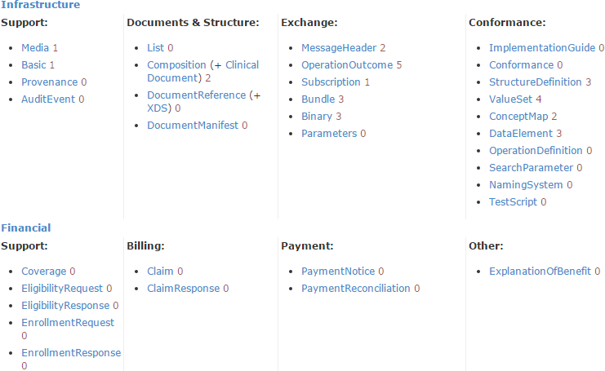
DSTU 2 Resource List

Slide 42
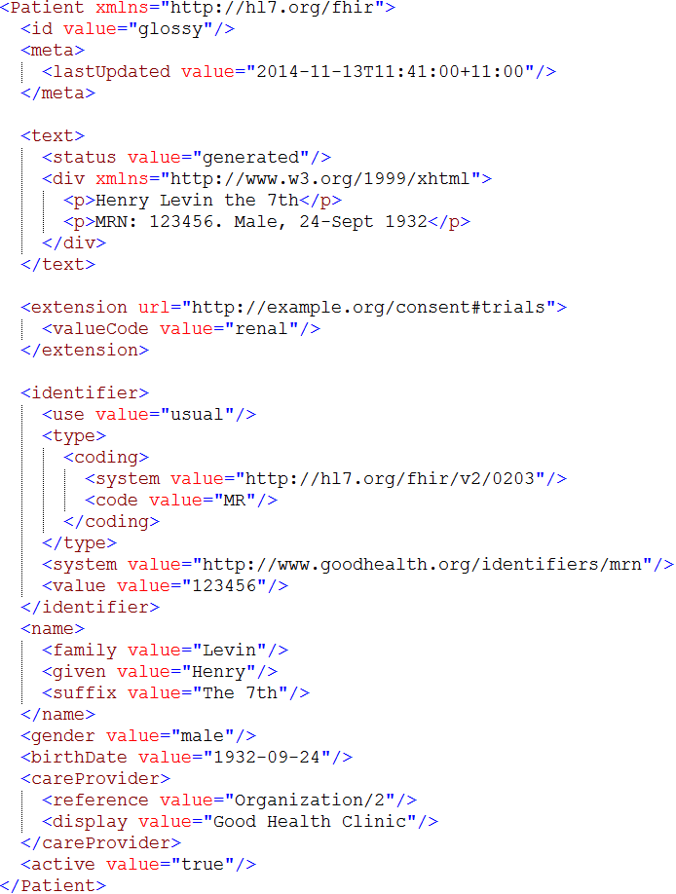
Identity & Metadata
Human Readable Summary
Extension with reference to its definition
Standard Data Content:
MRN
Name
Gender
Date of Birth
Provider
Notes:
System for gender is wrong . . .

Slide 43
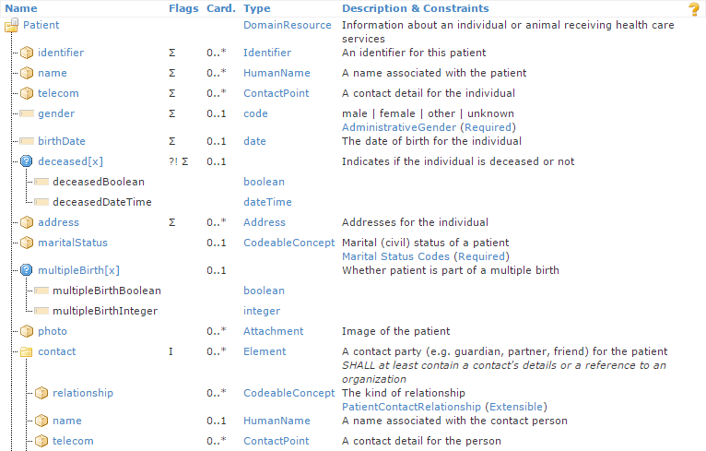
Resource Definitions

Slide 44
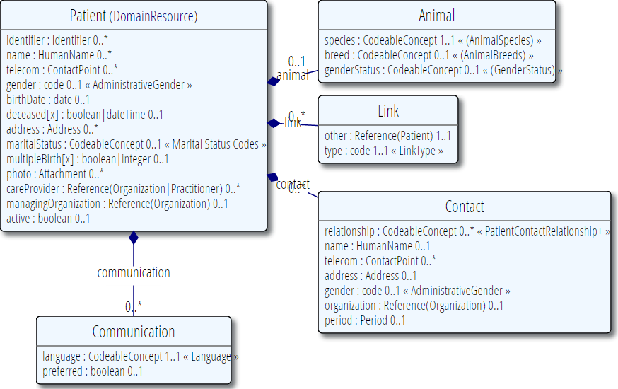
Resource Definitions

Slide 45
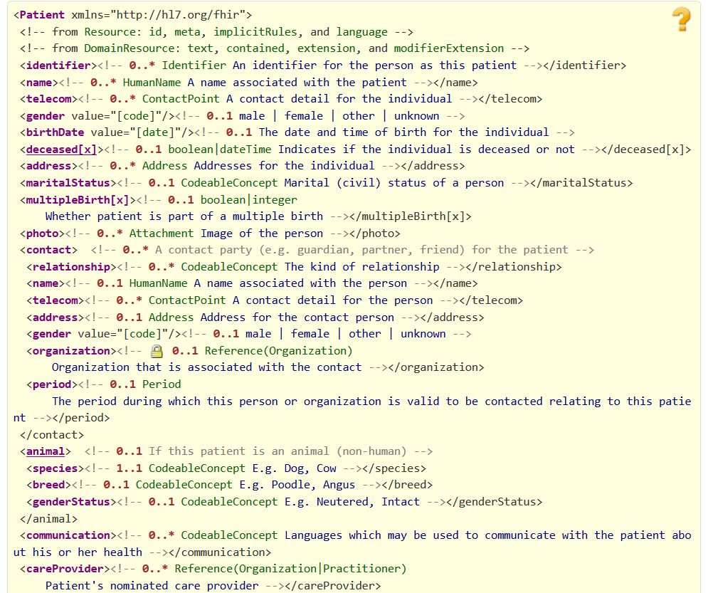
Resource Definitions

Slide 46
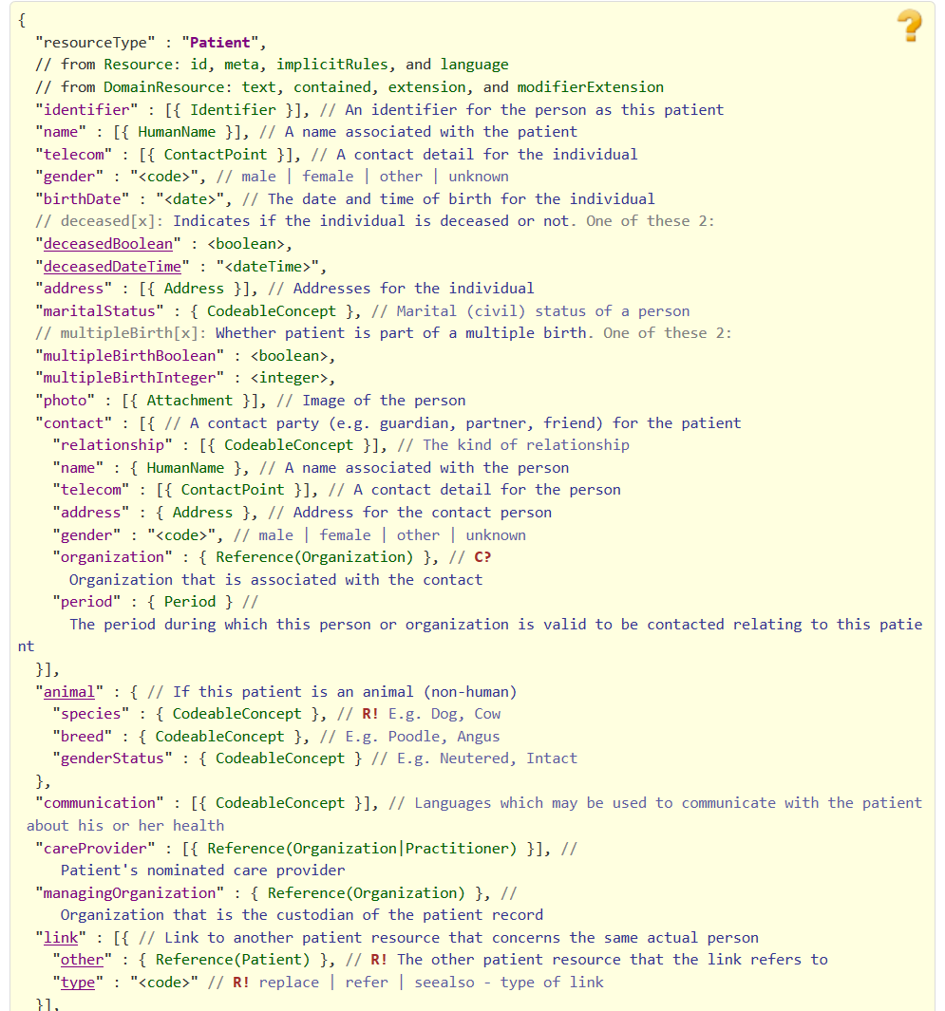
Resource Definitions

Slide 47
Why resources?
Increases re-use
Can use the same resource structures (and profiles on them) in many solutions
Lighter-weight communication
Can point to resources “by reference” rather than sending all data
Aligns well with how data is stored

Slide 48
What’s in a resource definition?
Each resource defines:
What elements are part of “core”
Names
Definitions
Cardinality
Code lists
Mappings (to RIM, v2 and other specs)
Constraints
All in a computable form
Create spec, schemas, reference implementations

Slide 49
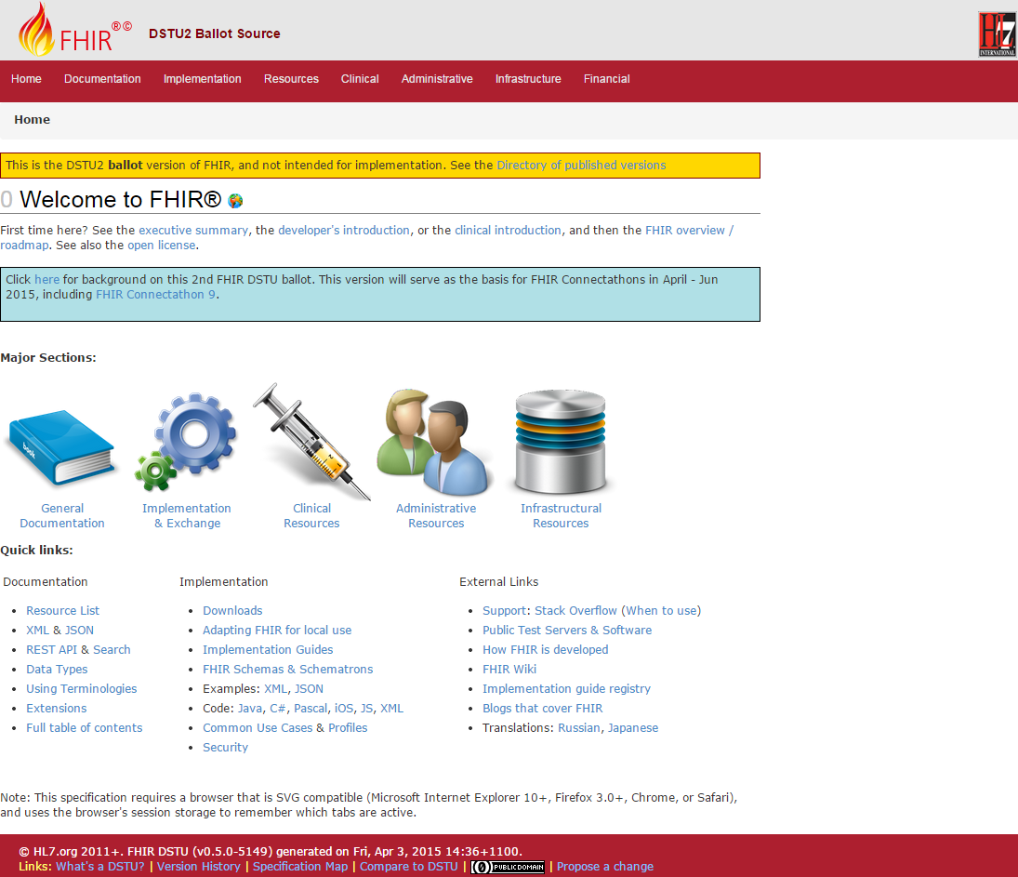
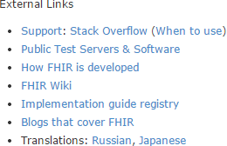
(FHIR home)
hl7.org/fhir
Notes:
Published as HTML
Published using validation process that performs consistency checks – like a software build
Really shouldn’t require much guidance to read, but a few things to call out
Objective of spec is developer can skim and decide in < day

Slide 50
How does FHIR compare?
Notes:
11:30

Slide 51
V2 and FHIR
Similarities
FHIR Differences
Built around re-usable “chunks” of data
Strong forward/backward compatibility rules
Extensibility mechanism
Each chunk (resource) is independently addressable
More than messages
Human readable required
Extensions don’t collide, are discoverable
Modern tools/skills
Instances easy to read
Lighter spec
Notes:
Many interface engine vendors working on FHIR support
May make sense for internals of some v2 systems
Add-on interface for mobile, personal health record

Slide 52
V3 and FHIR
Similarities
FHIR Differences
Based on RIM, vocab & ISO Data types foundations
Support XML syntax
Simpler models & syntax (reference model hidden)
Friendly names
Extensibility with discovery
Easy inter-version wire compatibility
Messages, documents, etc. use same syntax
JSON syntax too
Notes:
Lower learning curve
Unlikely to see significant new v3 initiatives in areas that aren’t already committed to it

Slide 53
FHIR and CDA
Similarities
FHIR Differences
Support profiling for specific use-cases
Human readability is minimum for interoperability
APIs, validation tooling, profile tooling
(See v3 similarities on prior slide)
Can use out of the box – no templates required
Not restricted to just documents
Implementer tooling generated with spec
(See v3 differences on prior slide)
Notes:
Significant work on CCDA <-> FHIR
Can use both FHIR and CCDA documents with XDS and with MHD

Slide 54
FHIR and Services
Similarities
FHIR differences
Encourage context neutral, re-usable structures with defined behavior
RESTful interface is a simple SOA interface
Consistent data structures across services
Ease of transport across paradigms message <-> service <-> document <-> REST
Standard framework for defining/discovering services
Notes:
FHIR allows defining simple services via the “OperationDefinition” mechanism as well as custom services.
E.g. Value set expansion, code translations – full terminology services

Slide 55
So why use anything else?
FHIR is brand new
Minimal market share
Not yet normative
Limited track record
Business case
No-one dumps existing working systems just because something new is “better”
Most Large projects committed to one standard won’t change direction quickly (or even at all)

Slide 56
FHIR as a replacement
Yes, FHIR has the potential to supplant HL7 v3, CDA and even v2
However
It’s probably not going to do so right away
HL7 will support existing product lines so long as the market needs them
Notes:
Few will throw away their investment in older standards to use FHIR until
The specification has a good track record
It’s clear the new thing provides significant benefits

Slide 57
Review
What are some of the key aspects of a resource?

Slide 58
Status of FHIR

Slide 59
FHIR Timeline (planned)
First Draft
1st
DSTU
~ 2nd
DSTU
~ 1st
Norm.
~ 2nd
Norm.
. . .
DSTU 2.1
2011
2012
2013
2014
2015
2016
2017
2018
2019
2020
Notes:
Note that dates are subject to change based on resources and the standards process

Slide 60
DSTU 2
Publish Sept 2015
Expected content includes:
Updates to existing content
Check tracker for proposal and agreed changes
Additional capabilities
Publish/subscribe, Web-based “push”, Operations
New resources
Referral, Coverage, Claim, Diet, Common Data Element
Profiles for CCDA 1.1

Slide 61
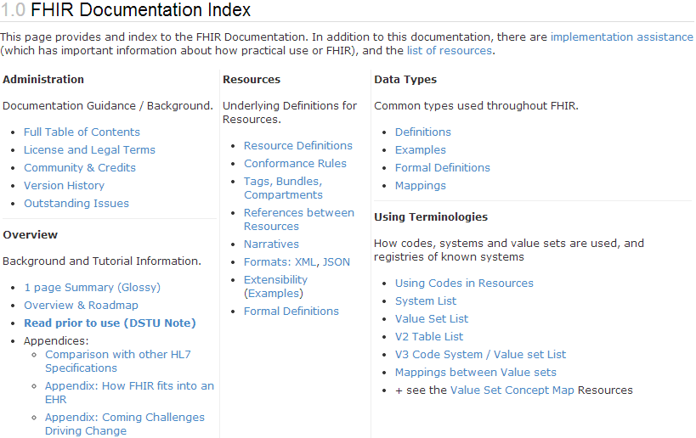
What does DSTU mean?
“…all aspects of the FHIR specification are potentially subject to change
Notes:
Split resources, dropped resources, changed JSON and XML syntax, added and changed elements, renamed data types

Slide 62
Maturity levels
Intended to indicate level of stability
FMM1 – Resource is “done”, no build warnings
FMM2 – Tested at approved Connectathon
FMM3 – Passes QA, has passed ballot
FMM4* – Tested across scope, published, prototype implementation
FMM5* – 5 distinct production implementations, multiple countries, 2
Non-compatible changes at level 4 and 5 will face increased hurdles

Slide 63
Normative FHIR
Will include
Core specification
Structural resources
Subset of other resources
Some resources won’t go normative right away
Future releases
Add more resources
Add profiles on existing resources
May add elements to resources
Very rare

Slide 64
Using FHIR

Slide 65
Where can FHIR be used?
Classic in-institution interoperability
Back-end e-business systems (e.g. financial)
Regional Health Information Organizations (RHIO)
National EHR systems
Social Web (Health)
Mobile Applications
Near
Term

Slide 66
Implementation during DSTU
FHIR is new
No commitment yet to backward compatibility
No stability guarantee until 2017+
Some resources don’t exist yet
Appointment, Referral, Insurance, Nutrition, etc.
However, implementers are choosing to build with it now
Notes:
Maybe they’re that desperate?

Slide 67
Who’s working with FHIR?
>150 organizations declared
attended a Connectathon and/or
signed up on wiki
Aware of many others not on either list
Almost 300 participants on the FHIR Implementer’s Skype chat
Probably scared away another 50%
20+ countries involved so far

Slide 68

FHIR & other SDOs
IHE
Using FHIR for MHD (mobile XDS)
FHIR profile for PIX/PDQ, CMAP, RECON, Accountable Order
DICOM
Building profile to make key images available to EHR
W3C
Semantic health group helping us with RDF, RIM-based semantic checking
Notes:
Because FHIR is free and because of how it’s structured, use by other SDOs is certainly possible CMAP = Clinical Mapping; RECON = reconciliation, Assessment of orders for accountable use criteria in guidelines

Slide 69
FHIR & the ONC
Structured Data Capture
Profiling FHIR to convey data elements, form designs and form data
Custom service to allow auto-populating forms based on CCDA or FHIR data
Data Access Framework
Profiling FHIR for meaningful use data access outside documents
Clinical Decision Support / Clinical Quality Measures
Using FHIR as their logical/physical model
Strong interest in FHIR for other purposes

Slide 70
FHIR & CDA
HL7 developing FHIR profiles for CCDA
Will have key ones present in next DSTU
HL7 project to define “Clinical Document Architecture” in FHIR
At least 3 projects looking at providing automated transformation between CCDA and FHIR

Slide 71
HSPC
Health Services Platform Consortium
Intermountain Healthcare, Veterans Affairs, Harris, Telus, Dignity Health, IBM, Epic, Cerner, Mayo, HP, Kaiser, +++ (not all are official members)
Leverage FHIR + security and additional layers to allow plug & play EHR modules
Stems from SMART on FHIR work

Slide 72
Case study 1
Who
Oridashi – Australian eHealth consultant/vendor
What
Use FHIR as primary care EMR integration interface to two leading primary care CISs.
Enables decision support, referral and personal health record portals.
When
Full production Fall, 2014

Slide 73
Case Study 2
Who
Healthcentrix.co – U.S. cloud-based PHR start-up
What
Community portal, PHR, mobile health assistant, device aggregator
XDS persistence integrated with a CCDA bridge (HISP Direct and HIE)
Patients, doctors and families share PHI, care plans & patient-generated data
When:
Alpha Feb (200 patients). Beta May, Prod: July

Slide 74
Case Study 3
Who
Choice-Hospital-Systems & Health Samurai (USA)
What:
CCHIT certified cloud-based EHR system
Open source FHIR server implementation
When
Available Fall 2014. Enhancing to support LOINC, SNOMED and advanced search and plug-ins for CDA, v2

Slide 75
Case Study 4
Who
Health & Social Care Information Centre (England)
What
National risk registry (profiling using Forge).
RESTful API for primary care. Initial focus on demographics + appointments, then health summaries, vaccinations, meds
When
Risk registry by mid-summer, API “in progress”

Slide 76
Case Study 5
Who
Intermountain Healthcare – provider org (USA)
What
Converting 3000+ detailed clinical models and their accompanying value sets to FHIR
Plan to use them with HSPCS
When
Complete public review within next 6 months

Slide 77
Case study 6
Who
Orion Health - vendor (New Zealand)
What
Updates to Integration engine to map v2 to FHIR
Read APIs for all CDR models
iOS Application to expose HealthKit data over FHIR to cloud based repository for viewing by patient and authorized providers
When
Engine – Q2 2015, APIs Q3, iOS Q4

Slide 78
Case Study 7
Who
University Health Network (Canada)
What
Replace existing custom SOAP interface to back-end systems (CDR, EMPI, HIS, etc.)
When
Production:
Registration/ADT, Clinical Document and Med order clinical portal portion production (2014)
Electronic discharge & medication summary
Notes:
Have also updated their HAPI v2 integration engine to support FHIR

Slide 79
Case Study 8
Who
UNICEF, USAID, IntraHealth, OpenMRS, +++
What
Sharing Practitioner, Location & Organization registry information over IHE’s CSD to SMS applications for front-line Ebola healthcare workers
When
Prod: Liberia in Aug.; Sierra Leonne, Guinnea fall
Rollout & expansion in several more countries over subsequent months

Slide 80
Case study takeaways
Broad international interest
Wide range of engagement
National initiatives
Care provider organizations
Small vendors/entrepreneurs
Mixture of green-field and upgrading existing systems
All with short times to production
Baby steps to full commitment

Slide 81
FHIR Risks
And mitigations

Slide 82
Risks with FHIR
FHIR is new
Be ready to migrate
Caution for mission critical applications
FHIR is cool
Be realistic about what’s achievable
Work with others (HL7, IHE, etc.) to build profiles
FHIR is coming
At minimum, monitor
Consider whether to pilot to build experience
Notes:
Still in DSTU
No backward compatibility guarantee
Some content missing
Limited production experience
Change is likely
Near the top of the hype curve
FHIR won’t fix all interoperability issues
Consensus, terminology, legacy burdens still exist
FHIR provides a framework and platform
Hard work still in profiling
Mitigations
Be realistic about what’s achievable
Work with others (HL7, IHE, industry groups) on the profiles you’ll need
Momentum is high – it will disrupt the health IT environment
Strong interest from regulators (e.g. ONC)
Strong interest from major vendors
Hitting at all points in the market chain
Plan what you could do, decide conditions for entry

Slide 83
Next Steps
For you and your organization

Slide 84

Next Steps
Is this something your organization wants/needs to track?
Monitor
Have someone sign up to the FHIR list or Skype chats
(instructions on the wiki)
http://wiki.hl7.org?title=FHIR
Engage
Have someone read through the specs
Send someone to development tutorials
Have your organization participate in or observe a connectathon
Participate in the upcoming DSTU ballot

Slide 85
Education opportunities
Attend a Working Group Meeting
Tutorials, Connectathons
May 8-14 Paris
October 2-9 Atlanta
Attend an Implementation Workshop
Intensive tutorials, hands-on
July 13-15 DC
November 16-18 Dallas
FHIR Institute Webinars
October 19-23
FHIR Developer Days
Amsterdam Nov 18-20th

Slide 86






International HL7 FHIR Developer Days November 18-20, 2015 in Amsterdam
Education
14 tutorials
pick & choose
Connectathon
Meet fellow developers
Put FHIR to the test
Networking
FHIR experts and authors on hand
http://fhir.furore.com/devdays

Slide 87
Final message
FHIR
is easier and cheaper
is being implemented now
is likely to significantly impact Health IT
Decide how you want it to impact your organization

Slide 88

Questions?
http://hl7.org/fhir lmckenzie@gevityinc.com

